Slide 1
COVID-19 Tracking Germany
https://www.kaggle.com/datasets/headsortails/covid19-tracking-germany
https://github.com/doctorf72/Naya-Practical-Data-Science-EDA-Project
Felix Doktorman & Alin Finkelshtein

Slide 2
Background
Coronavirus disease (COVID-19) is an infectious disease caused by the SARS-CoV-2 virus.
The first known case was identified in China Wuhan at December 2019.
The disease quickly spread worldwide, resulting in the COVID-19 pandemic.
This dataset provides daily updated number of reported cases & deaths in Germany on state and county level from January 2020.
A dataset on vaccination progress from December 2020.
And a general state-level population demographics.

Slide 3
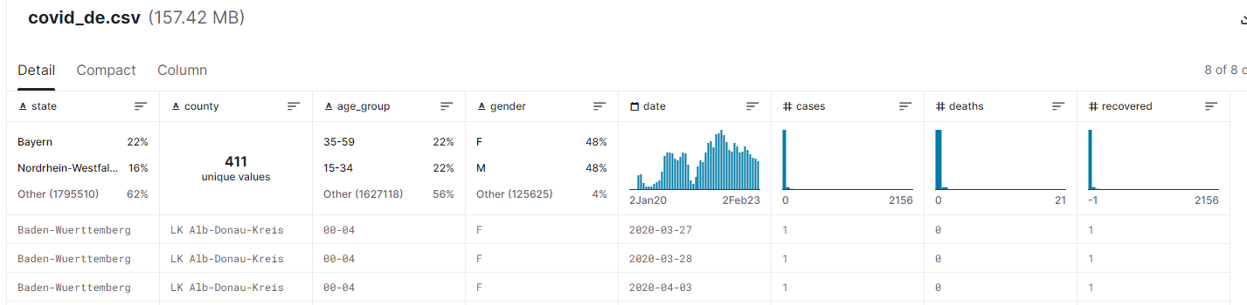
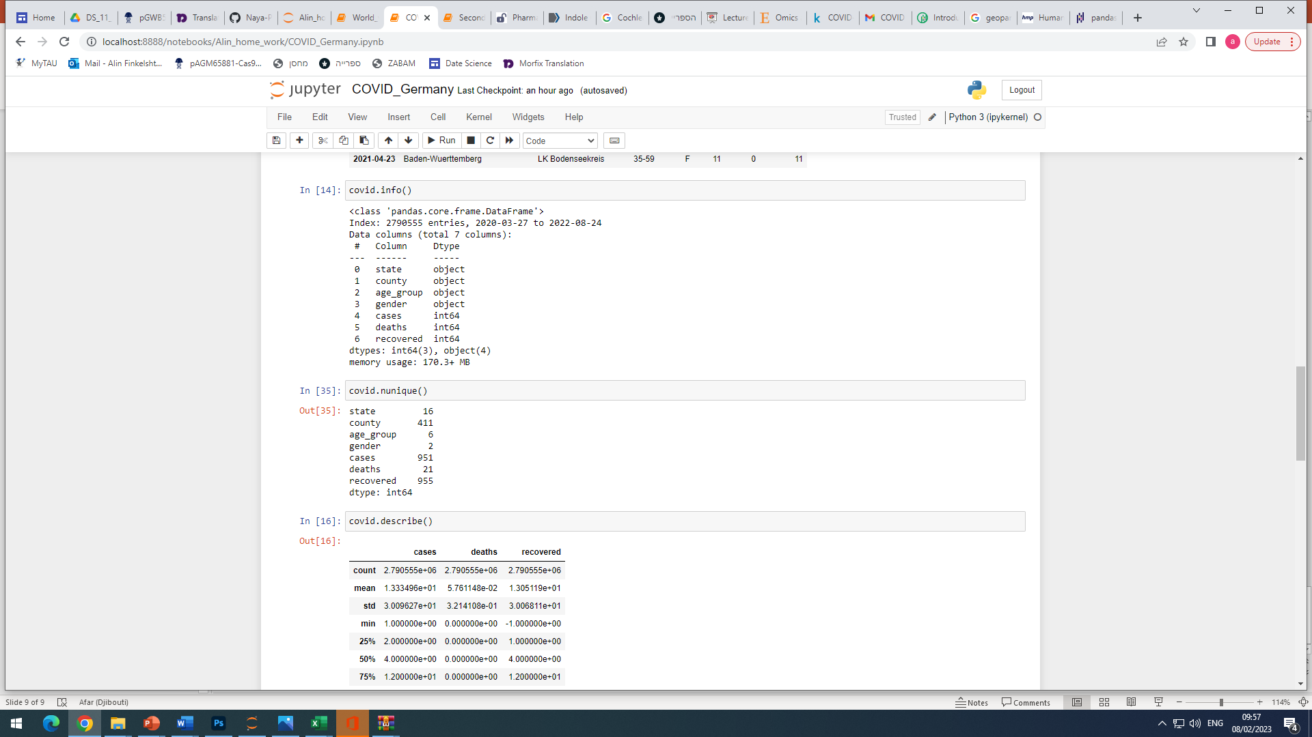
Dataset contains 3 tables:
covid_de.csv
Nunique
…………….

Slide 4
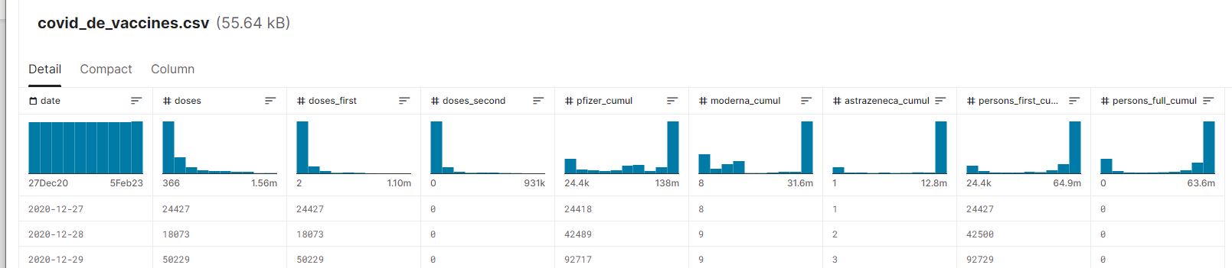
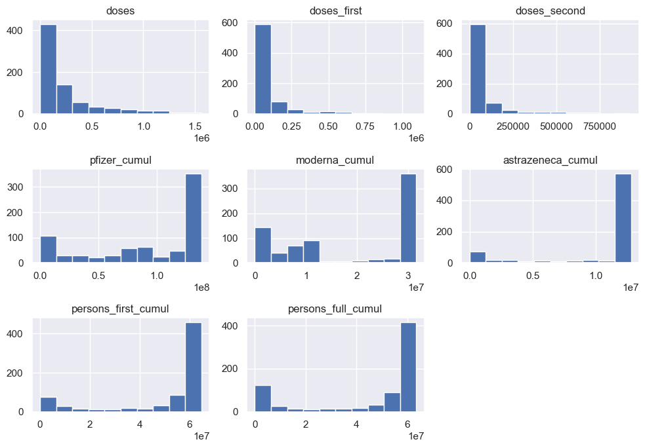
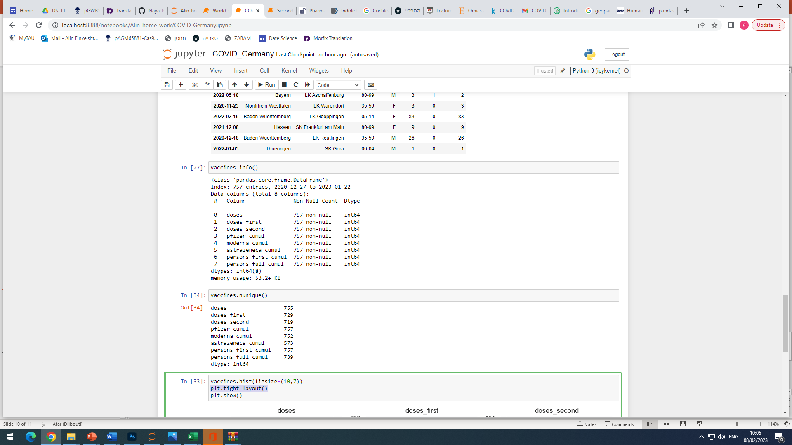
covid_de_vaccines.csv
Nunique
…………….

Slide 5
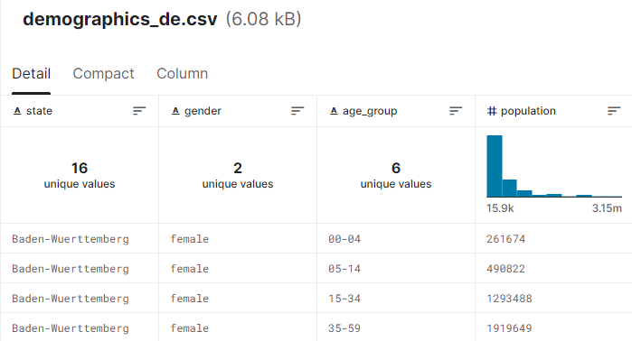
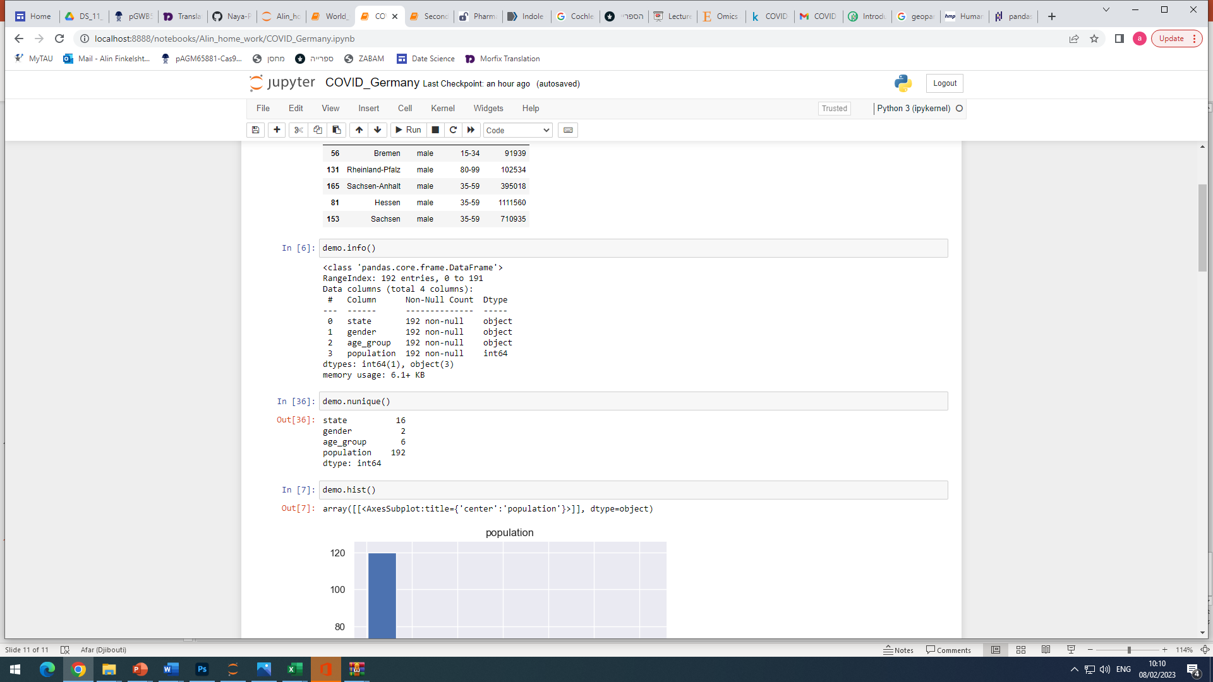
demographics_de.csv
Nunique
…………….

Slide 6
Data analysis

Slide 7
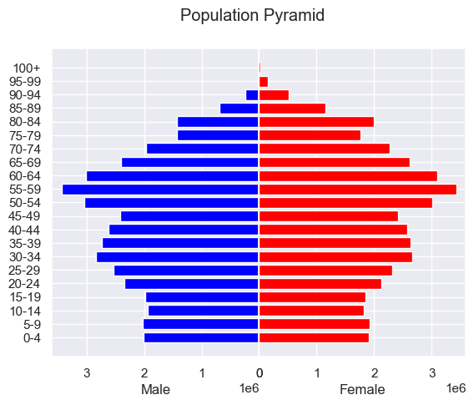
Population in Germany
Post-reproductive – 51.2%
We would expect to see high death rates due to prevalence of old population.
However, total death ratio in Germany is only 0.43%
Reproductive -35.2%
Pre-reproductive -14%
Total population = 83,019213

Slide 8
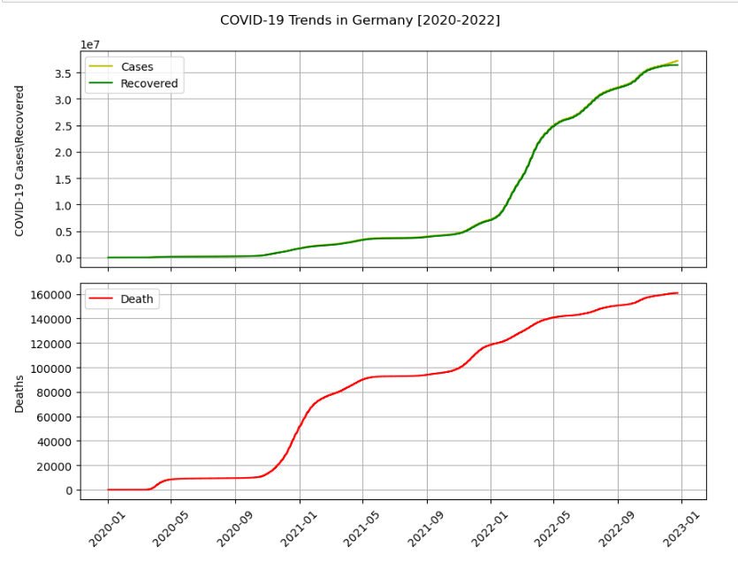
Time trends for cumulative cases, recoveries and deaths
Based on data set we are looking into cumulative counts of cases, recovered cases and deaths in Germany during 2020 – 2022.
Observation that recovery counts correlate with overall cases.
Few periods observed in deaths trends that should be understood.
97.8% recovery

Slide 9
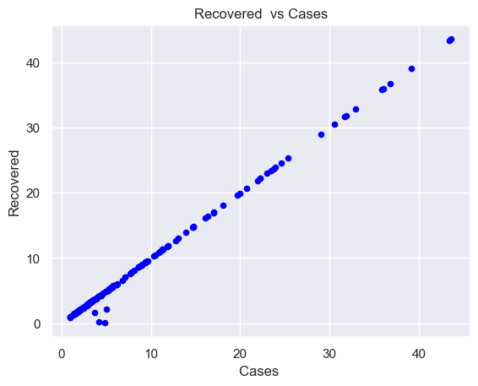
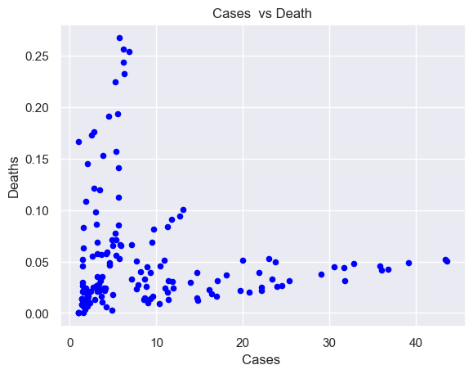
Correlations
Observed correlation between cases and number of recoveries
But no correlation between cases and death.

Slide 10
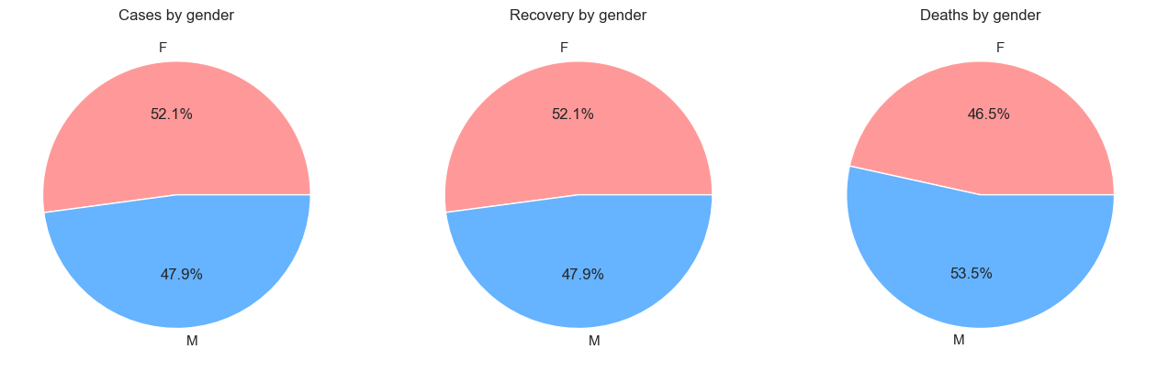
COVID 19 cases, recovery and death rates by gender
No significant difference observed in cases and recovery rate.
While, the death rate is a bit more in males.

Slide 11
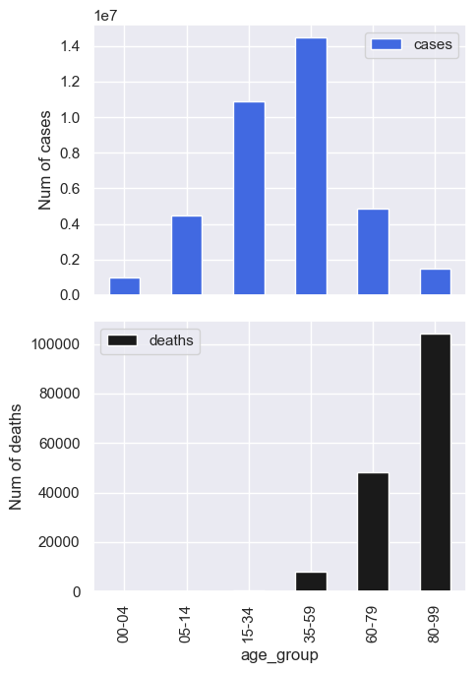
Are certain age groups have more tendency to infection and /or death?
Infection
Young children (>14) and old people (60+) have less tendency for covid infection.
Alternatively are asymptomatic and are not revealed (Children)
Have a problem to do the test and are not revealed (Aged)
Were isolated and thus were less infected
Young adults and mature population are infected more.
Death
The older you are the higher are your chances to die from COVID19.

Slide 12
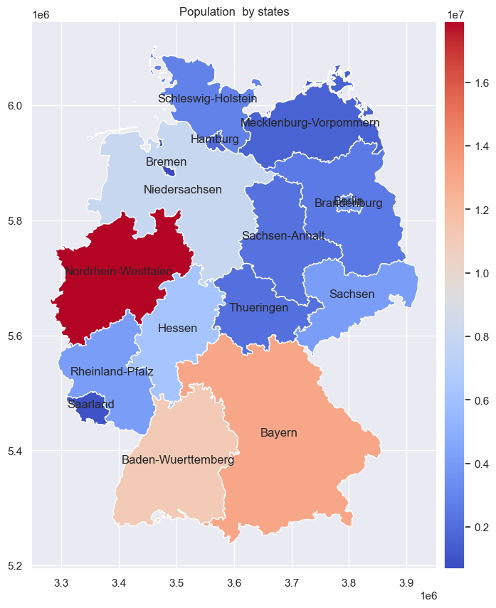
Germany’s demography
Germany is divided to 16 states and 411 counties
The most populated states are:
Nordrhein-Westfalen
Baden-Wuerttemberg
Bayern

Slide 13
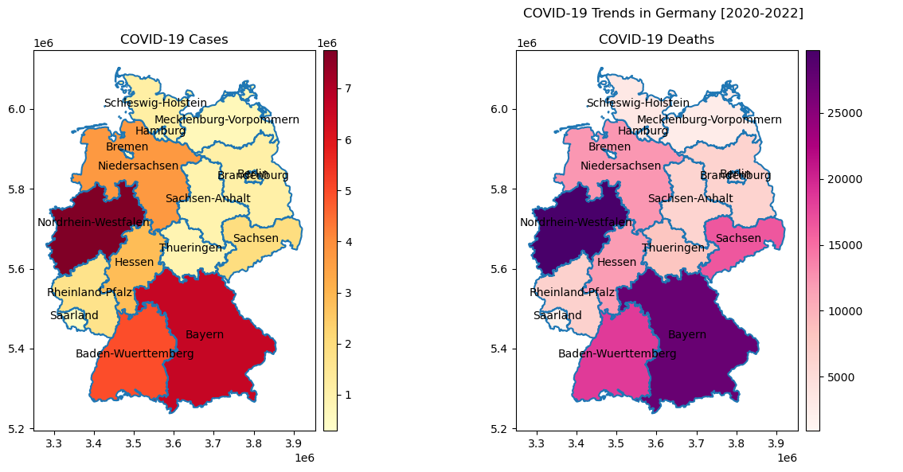
There is clear correlation between population density and number of cases/deaths

Slide 14
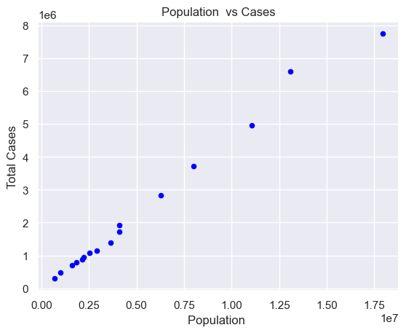
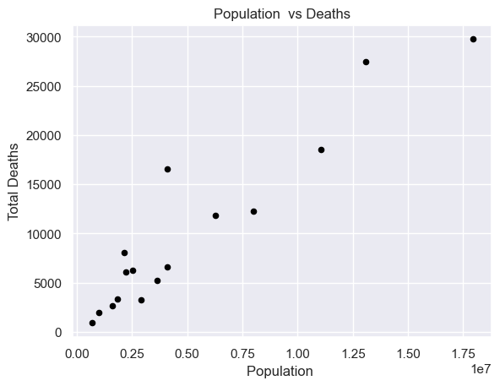
There is clear correlation between population and number of cases/deaths

Slide 15
There are 3 states with most population, cases and deaths. Lets test them by counties

Slide 16
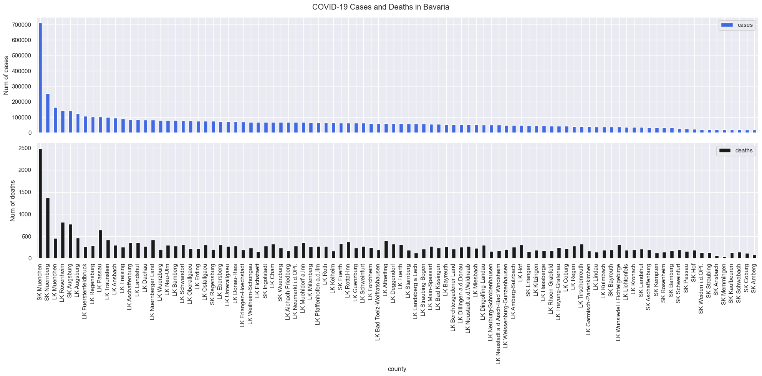
Bavaria

Slide 17
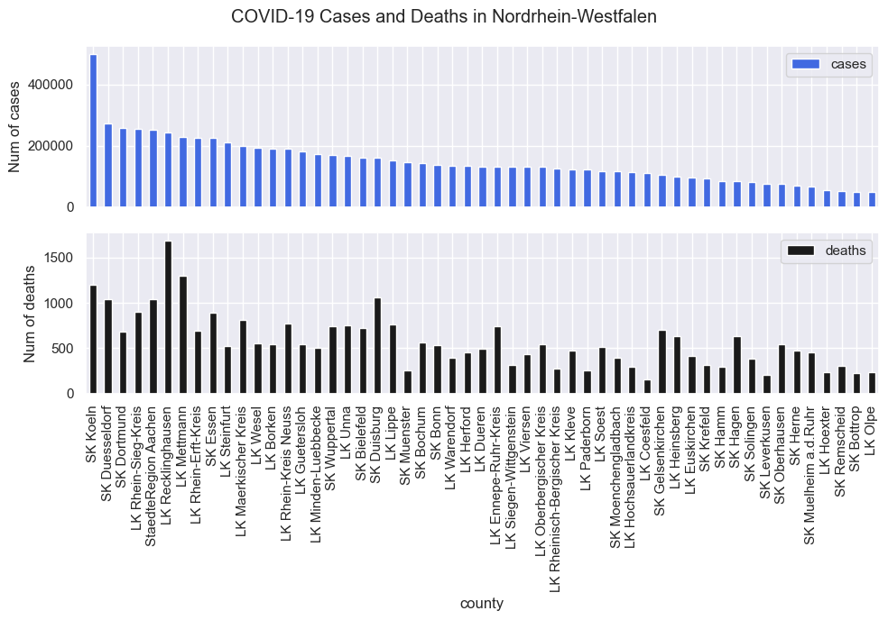
Nordrhein-Westfalen

Slide 18
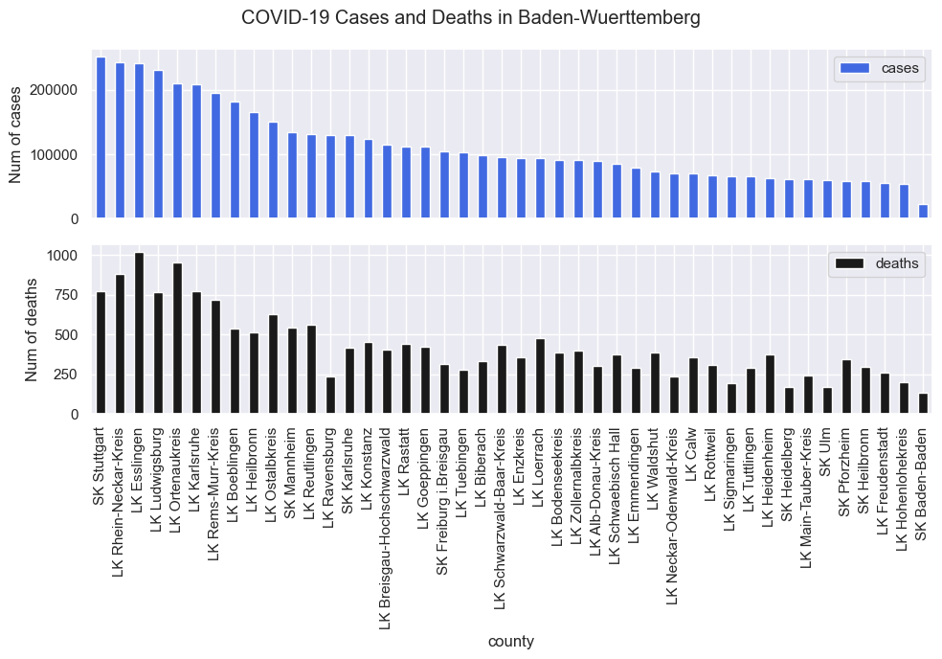
Baden-Wuerttemberg

Slide 19
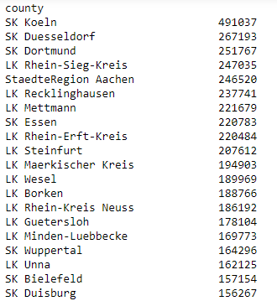
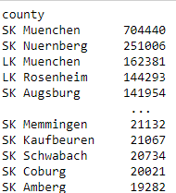
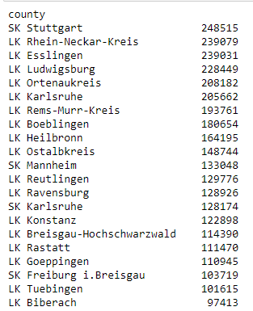
We can see that most cases are concentrated in the big cities :
Nordrhein-Westfalen
Bavaria
Baden-Wuerttemberg

Slide 20
Vaccination analysis in Germany

Slide 21
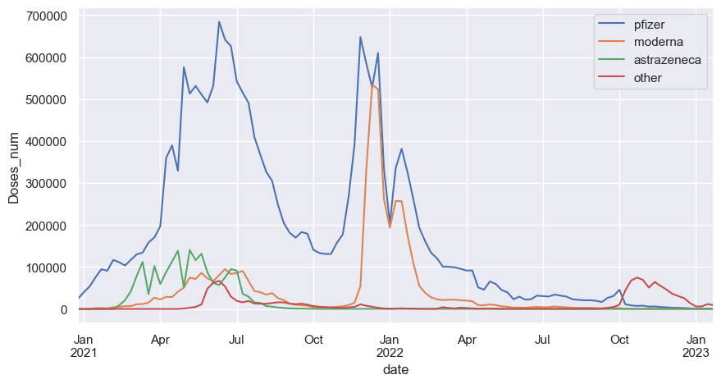
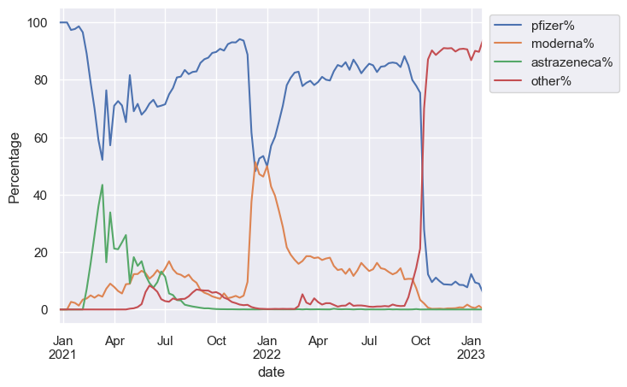
What is the contribution of each manufacturer?
There are 3 main manufacturers in Germany: Pfizer, moderna and astrazeneca.
The most commonly used is Pfizer
In Jan 22 it was a reduction in pfizer use that was replaced by moderna.
Astrazeneca was mainly used in the beginning: Feb-Jul 21 and abandoned afterwards.
Other manufacturers are used from Oct 2022

Slide 22
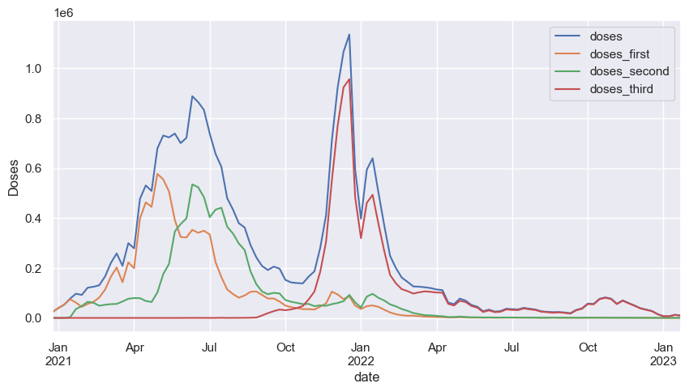
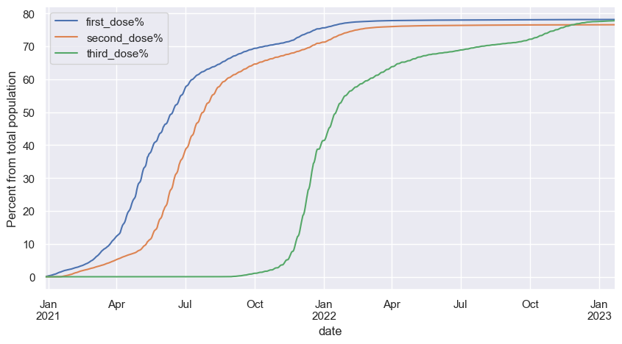
Vaccination patterns
With the appearance of the vaccines most of the population (~60%) got first and second dose.
Starting from Nov 2022 again most of the population (~60%) got the third dose.
Remaining population show a decrease ratios of vaccination, however, 78% are vaccinated with 3 doses today in Germany.
Conclusion – most population is very disciplined and obeys the government guidance.

Slide 23

Was the vaccination necessary?

Slide 24
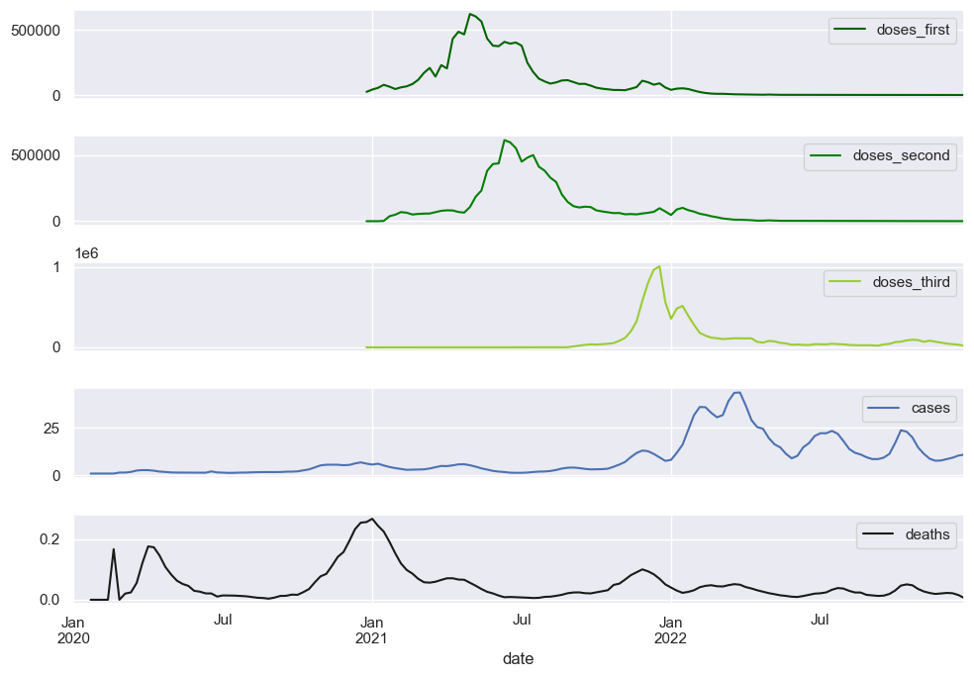
The effect of vaccination on number of cases and deaths
There is no effect on number of cases ) chance to get infected), but the number of deaths decreased following the vaccination.
The death ratio before the beginning of vaccination was 2.8% following 3 doses of vaccination it decreased to 0.16%!
2.8%
0.16%

Slide 25
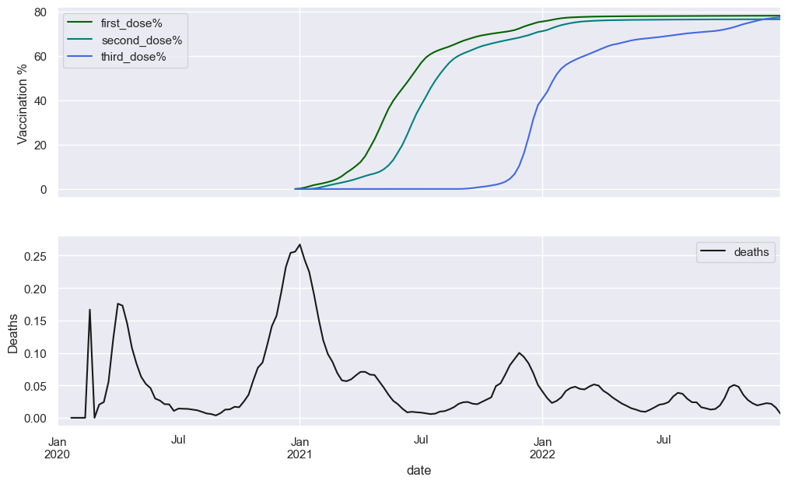
After first dose of vaccination the death rate decreased from 2.5% to 0.21%
2.5%
0.21%
60% vaccination

Slide 26
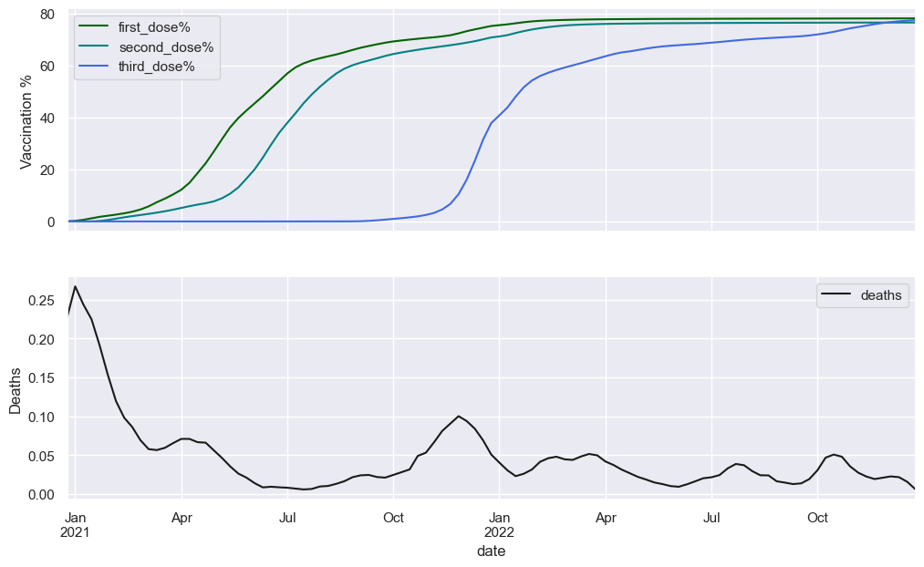
Death rate from the beginning of vaccination
0.6%
0.16%
60% vaccination

Slide 27
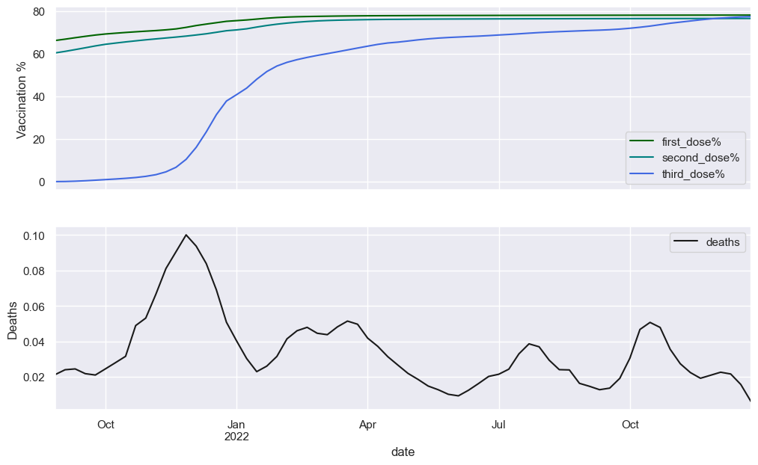
The 3rd dose of vaccination had beneficial effect on death rates even after two doses.
0.3%
0.16%
60% vaccination

Slide 28
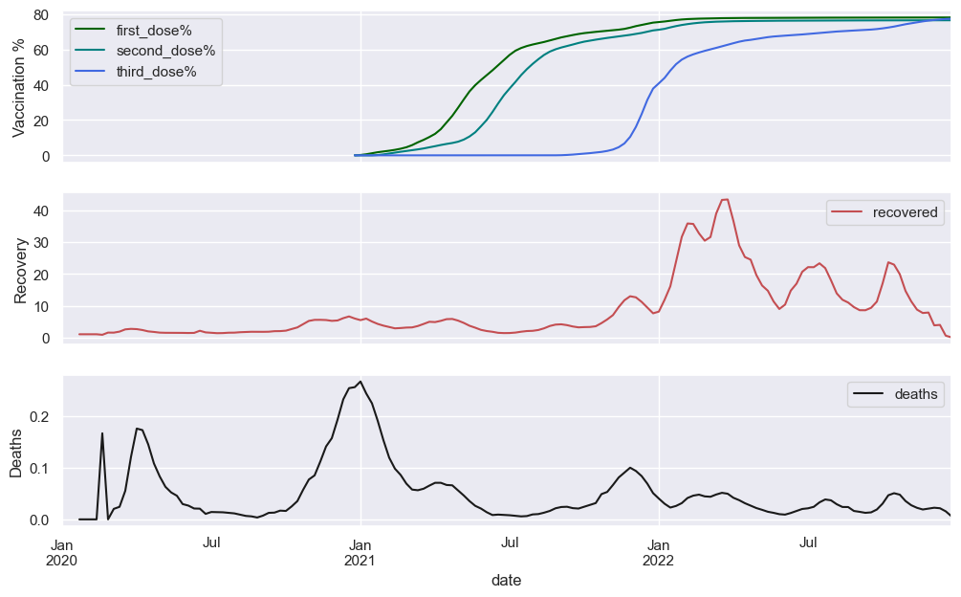
Alternative explanation could be natural immunization due to recovery.
Death ratio before
Death ratio after
2.8%
1.9%
0.32%
4.4%
0.21%
2.5%
18.6%
0.16%
0.83%
Beginning of vaccination
60% got the 1st dose
60% got the 3rd dose

Slide 29
Alternative explanation could be natural immunization due to recovery.
The ratio of recovery/natural immunization is too low to be responsible for decrease in death rates.

Slide 30
Was the vaccination necessary?
Defiantly YES!

Slide 31
Summary
97.9% of all cases recovered from COVID
Correlation was found between cases and recovery but not between cases and deaths.
Correlation was found between most populated states/counties and number of cases/deaths
Ages 15-59 show more tendency to get infected.
Ages 60+ show higher death rates.
0.43% of all cases died from COVID.
There is a slightly more deaths in males (53.5%) then in females (46.5%)
78% of population got 3 doses of vaccines.
Vaccination decreased death but not infection rates.
The most widespread manufacturer in Germany is Pfizer.
Although, more than 50% of population is in post reproductive age the total death rate is only 0.43%.

